Slide 1
INTRODUCTION TO COMPUTING
Course Code: CCINCOM/L
More RL Concepts
Elizer Ponio Jr.
Faculty Member
Department of Computer Science
College of Computing and Information Technologies (CCIT)
National University
Joseph Marvin R. Imperial
REINFORCEMENT LEARNING
NU College of Computing and Information Technologies
Course Code: CCRNFLRL

Slide 2
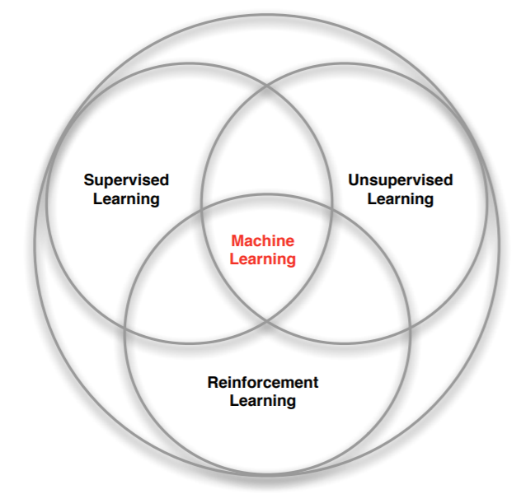
Branches of Machine Learning
INTRODUCTION TO COMPUTING
Course Code: CCINCOM/L
Review in Probability, Intro to RL Concepts
Joseph Marvin R. Imperial
REINFORCEMENT LEARNING
NU College of Computing and Information Technologies
Course Code: CCRNFLRL

Slide 3
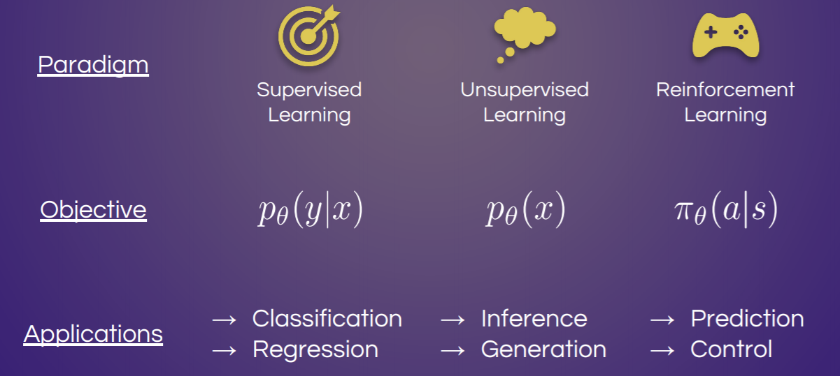
Types of Learning
INTRODUCTION TO COMPUTING
Course Code: CCINCOM/L
Review in Probability, Intro to RL Concepts
Joseph Marvin R. Imperial
REINFORCEMENT LEARNING
NU College of Computing and Information Technologies
Course Code: CCRNFLRL

Slide 4
Reinforcement Learning (RL)
INTRODUCTION TO COMPUTING
Course Code: CCINCOM/L
RL is learning from interaction.
Decisions in sequence does matter as they affect the outcome of subsequent decisions.
It is distinguished from other computational approaches by its emphasis on learning by an agent from direct interaction with its environment, without requiring exemplary supervision or complete models of the environment.
Review in Probability, Intro to RL Concepts
Joseph Marvin R. Imperial
REINFORCEMENT LEARNING
NU College of Computing and Information Technologies
Course Code: CCRNFLRL

Slide 5
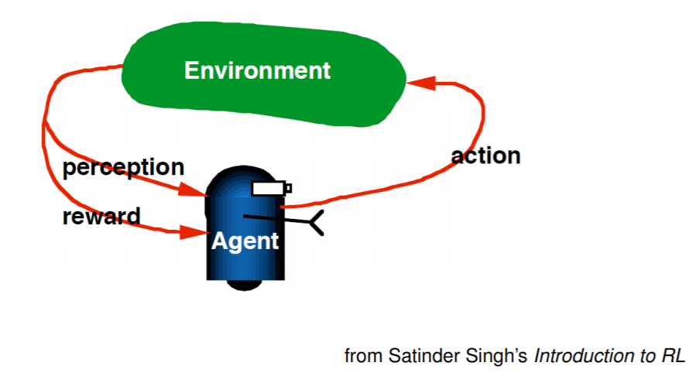

Reinforcement Learning (RL)
INTRODUCTION TO COMPUTING
Course Code: CCINCOM/L
Review in Probability, Intro to RL Concepts
Joseph Marvin R. Imperial
REINFORCEMENT LEARNING
NU College of Computing and Information Technologies
Course Code: CCRNFLRL

Slide 6
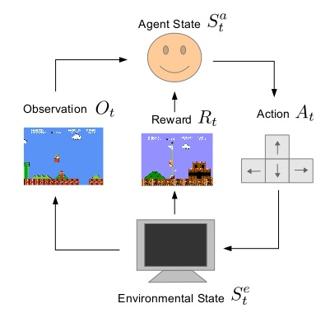
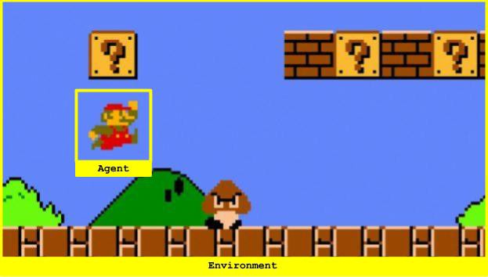
Super Mario
INTRODUCTION TO COMPUTING
Course Code: CCINCOM/L
Review in Probability, Intro to RL Concepts
Joseph Marvin R. Imperial
REINFORCEMENT LEARNING
NU College of Computing and Information Technologies
Course Code: CCRNFLRL

Slide 7
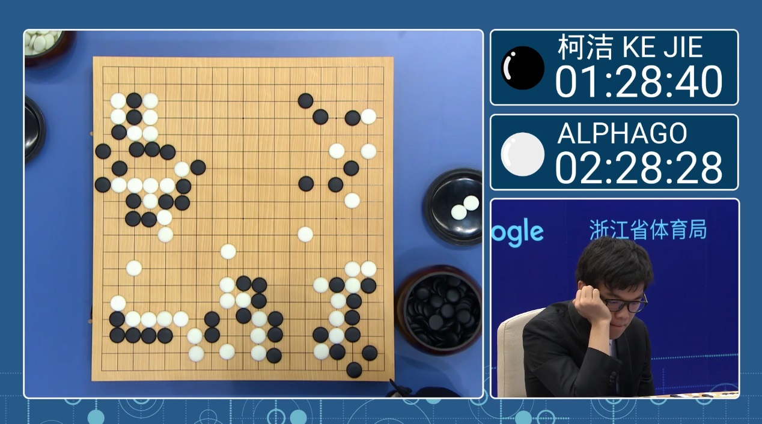


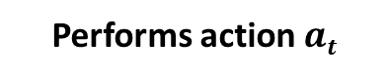

AlphaGo
INTRODUCTION TO COMPUTING
Course Code: CCINCOM/L
Observation of current state $st$
Lee Sedol (Opponent)
Reward is given if game is won.
Performs action $at$
Joseph Marvin R. Imperial
REINFORCEMENT LEARNING
NU College of Computing and Information Technologies
Course Code: CCRNFLRL

Slide 8
Characteristics of Reinforcement Learning
INTRODUCTION TO COMPUTING
Course Code: CCINCOM/L
What makes reinforcement learning different from other machine learning paradigms?
There is no supervisor, only a reward signal.
Feedback is delayed, not instantaneous.
Time really matters (sequential decision making).
Agent’s actions affect the subsequent data it receives.
Review in Probability, Intro to RL Concepts
Joseph Marvin R. Imperial
REINFORCEMENT LEARNING
NU College of Computing and Information Technologies
Course Code: CCRNFLRL

Slide 9
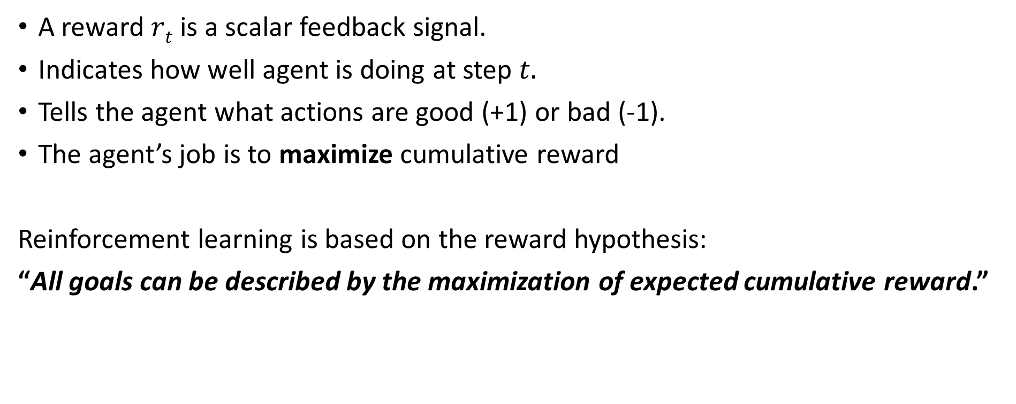
The Reward Function
INTRODUCTION TO COMPUTING
Course Code: CCINCOM/L
A reward $rt$ is a scalar feedback signal.
Indicates how well agent is doing at step $t.$
Tells the agent what actions are good (+1) or bad (-1).
The agent’s job is to maximize cumulative reward
Reinforcement learning is based on the reward hypothesis:
“All goals can be described by the maximization of expected cumulative reward.”
Joseph Marvin R. Imperial
REINFORCEMENT LEARNING
NU College of Computing and Information Technologies
Course Code: CCRNFLRL

Slide 10
Examples of Reward Functions
INTRODUCTION TO COMPUTING
Course Code: CCINCOM/L
Fly stunt maneuvers in a helicopter
+ reward for following desired trajectory
- reward for crashing
Defeat the world champion at Backgammon / Go
+ reward for winning a game
- reward for losing a game
Make a humanoid robot walk
+ reward for forward motion
− reward for falling over
Play many different Atari games better than humans
+ reward for increasing the score
- reward for decreasing the score
Joseph Marvin R. Imperial
REINFORCEMENT LEARNING
NU College of Computing and Information Technologies
Course Code: CCRNFLRL

Slide 11
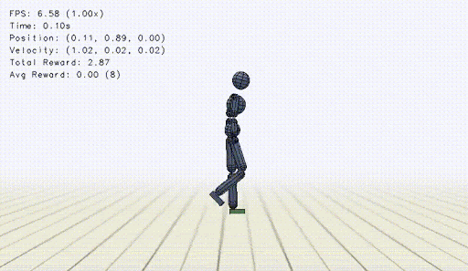
Examples of Reward – Learning to Walk
INTRODUCTION TO COMPUTING
Course Code: CCINCOM/L
Joseph Marvin R. Imperial
REINFORCEMENT LEARNING
NU College of Computing and Information Technologies
Course Code: CCRNFLRL

Slide 12
Sequential Decision Making
INTRODUCTION TO COMPUTING
Course Code: CCINCOM/L
Goal is to select actions to maximize total future reward.
Actions may have long term consequences.
Reward may be delayed. It may be better to sacrifice immediate reward to gain more long-term reward.
Examples:
A financial investment (may take months to mature)
Refueling a helicopter (might prevent a crash in several hours)
Blocking opponent moves (might help winning chances many moves from now)
In games, taking a risky move only to become useful in the future.
Review in Probability, Intro to RL Concepts
Joseph Marvin R. Imperial
REINFORCEMENT LEARNING
NU College of Computing and Information Technologies
Course Code: CCRNFLRL

Slide 13
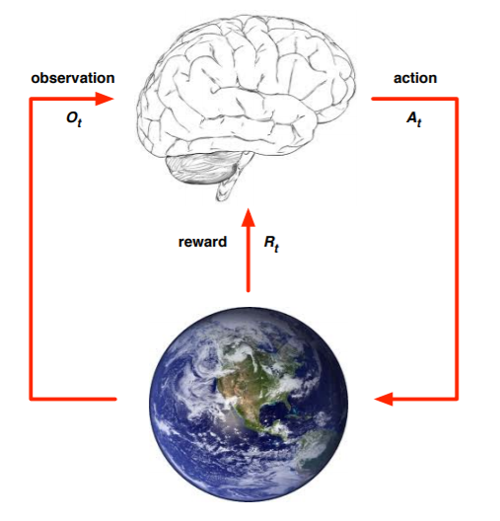
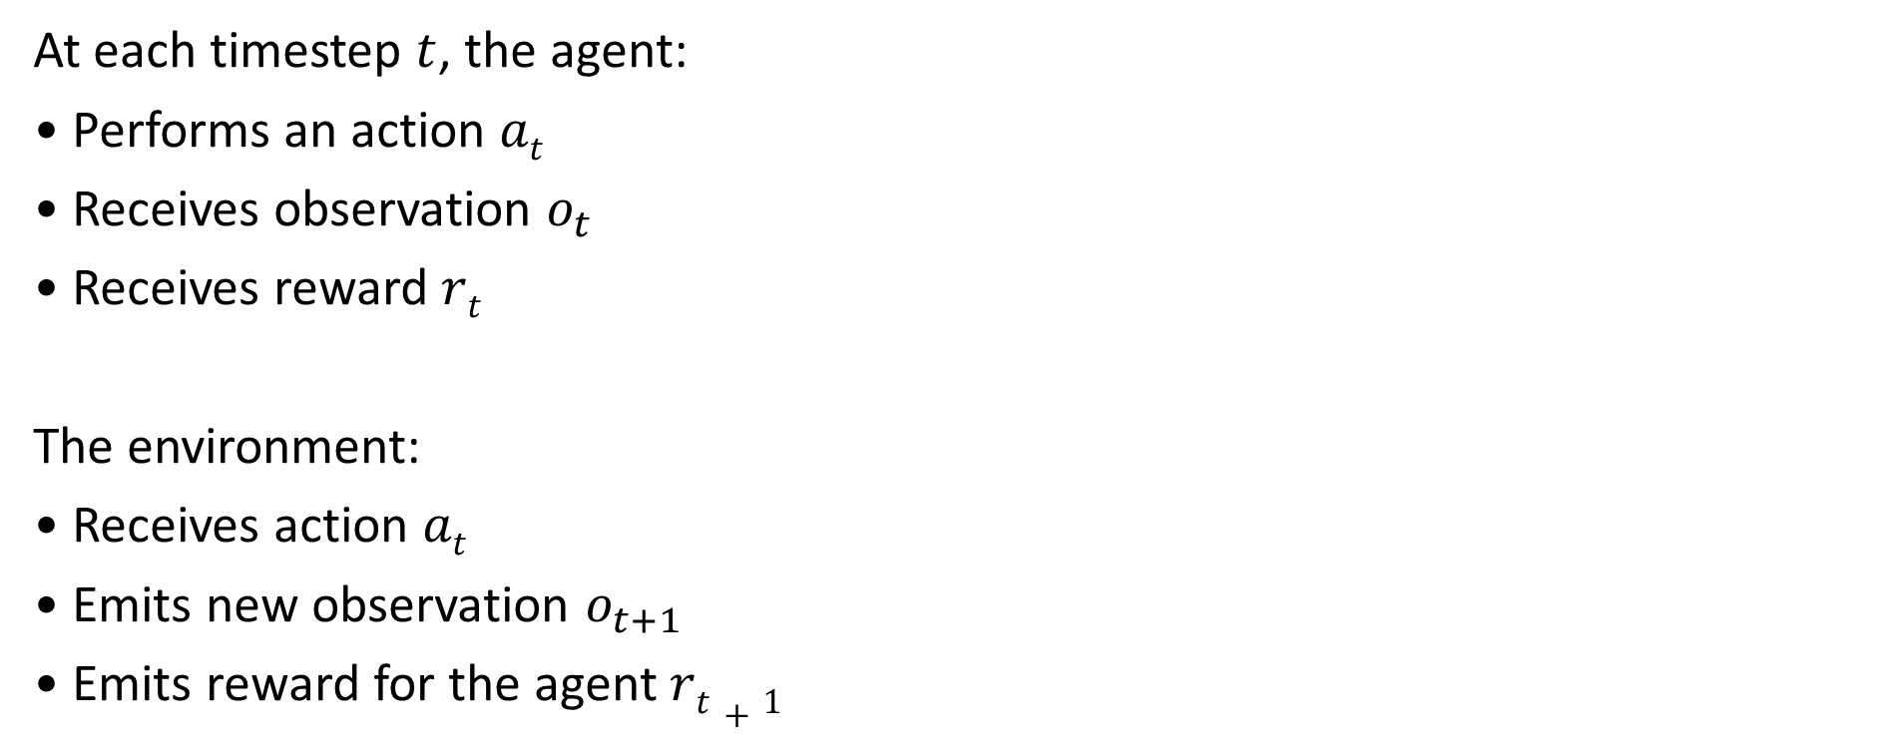
The Agent and the Environment
INTRODUCTION TO COMPUTING
Course Code: CCINCOM/L
At each timestep $t$, the agent:
• Performs an action $at$
• Receives observation $o_{t}$
• Receives reward $rt$
The environment:
• Receives action $at$
• Emits new observation $o_{t+1}$
• Emits reward for the agent $rt+1$
Joseph Marvin R. Imperial
REINFORCEMENT LEARNING
NU College of Computing and Information Technologies
Course Code: CCRNFLRL

Slide 14
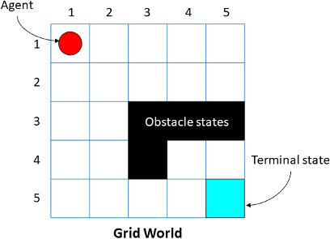
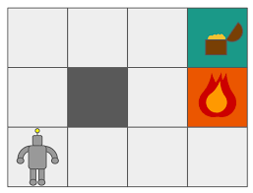
The Agent and the Environment
INTRODUCTION TO COMPUTING
Course Code: CCINCOM/L
Joseph Marvin R. Imperial
REINFORCEMENT LEARNING
NU College of Computing and Information Technologies
Course Code: CCRNFLRL

Slide 15
Activity
INTRODUCTION TO COMPUTING
Course Code: CCINCOM/L
Frame one game/problem into a reinforcement learning setup. Identify the following:
Problem/Game
Environment
Agent
Actions of the agent
Reward Function
Review in Probability, Intro to RL Concepts
Joseph Marvin R. Imperial
REINFORCEMENT LEARNING
NU College of Computing and Information Technologies
Course Code: CCRNFLRL

Slide 16
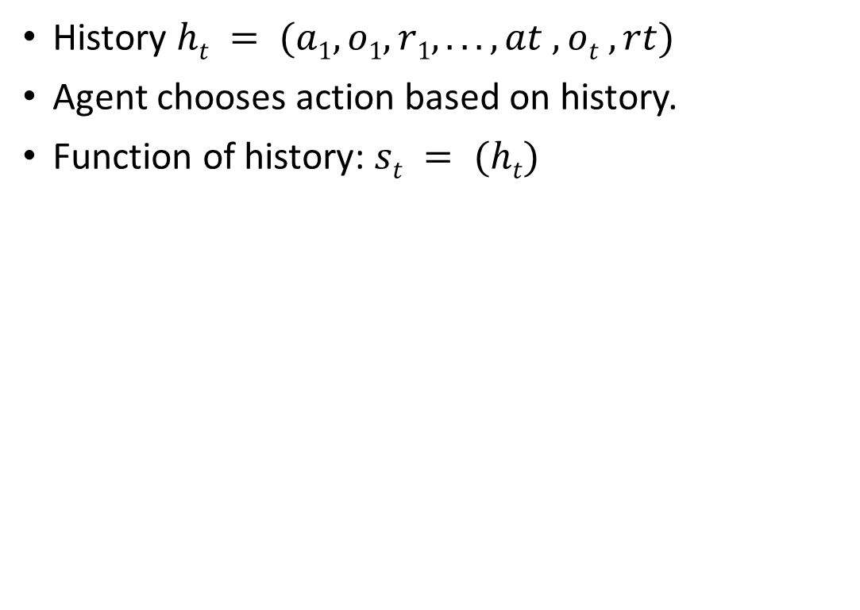
The History
INTRODUCTION TO COMPUTING
Course Code: CCINCOM/L
History $ht = (a1, o1,r1, . . . , at , ot ,rt)$
Agent chooses action based on history.
Function of history: $st = (ht)$
Joseph Marvin R. Imperial
REINFORCEMENT LEARNING
NU College of Computing and Information Technologies
Course Code: CCRNFLRL

Slide 17
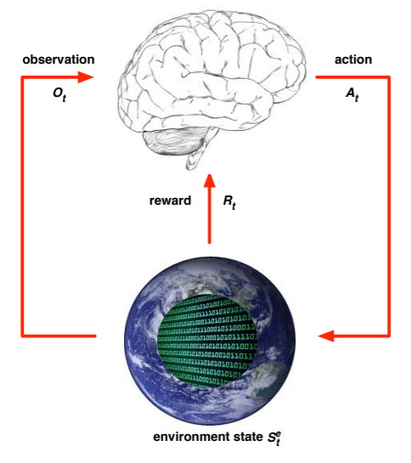
World State
INTRODUCTION TO COMPUTING
Course Code: CCINCOM/L
This is true state of the world used to determine how world generates next observation and reward.
Often hidden or unknown to agent.
Even if known may contain information not needed by agent.
Joseph Marvin R. Imperial
REINFORCEMENT LEARNING
NU College of Computing and Information Technologies
Course Code: CCRNFLRL

Slide 18
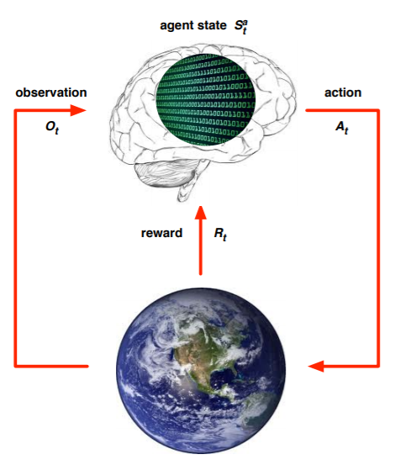
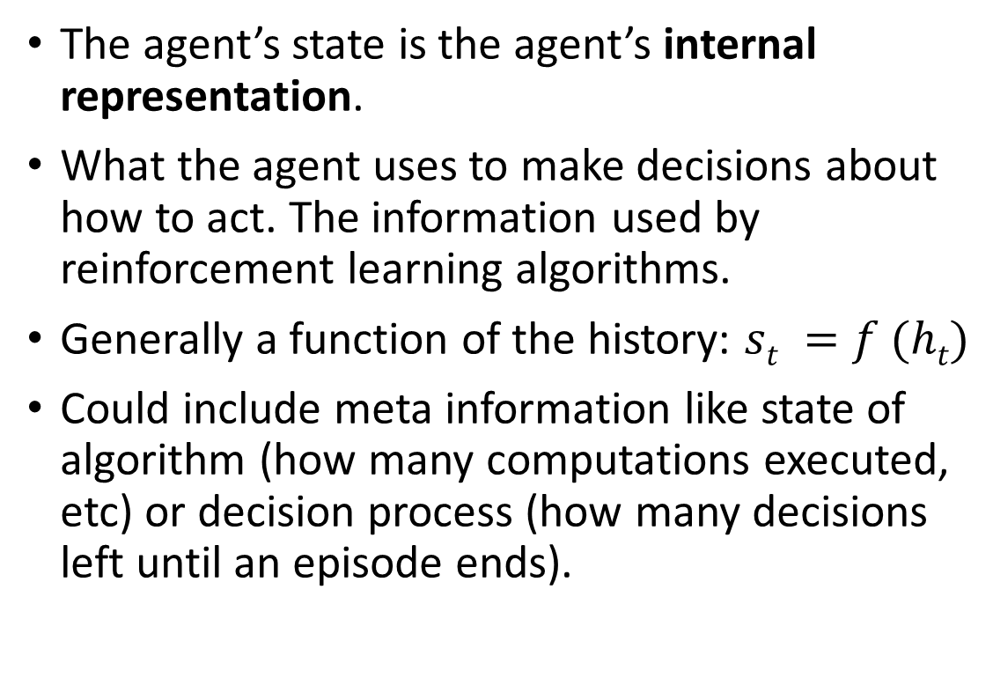
Agent’s Internal Representation
INTRODUCTION TO COMPUTING
Course Code: CCINCOM/L
The agent’s state is the agent’s internal representation.
What the agent uses to make decisions about how to act. The information used by reinforcement learning algorithms.
Generally a function of the history: $st =f (ht)$
Could include meta information like state of algorithm (how many computations executed, etc) or decision process (how many decisions left until an episode ends).
Joseph Marvin R. Imperial
REINFORCEMENT LEARNING
NU College of Computing and Information Technologies
Course Code: CCRNFLRL

Slide 19
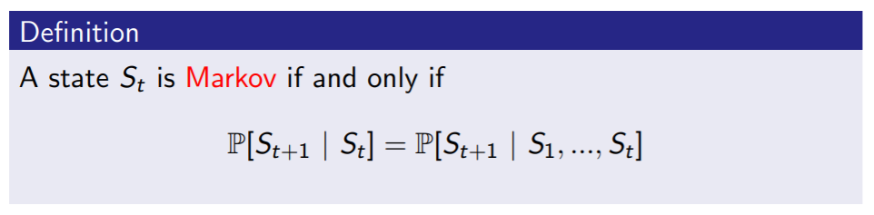
Information State
INTRODUCTION TO COMPUTING
Course Code: CCINCOM/L
An information state (a.k.a. Markov state) contains all useful information from the history.
“The future is independent of the past given the present.”
Once the state is known, the history may be thrown away because our current state already captures the information of the past states.
The (current) state is a sufficient statistic of the future.
Joseph Marvin R. Imperial
REINFORCEMENT LEARNING
NU College of Computing and Information Technologies
Course Code: CCRNFLRL

Slide 20
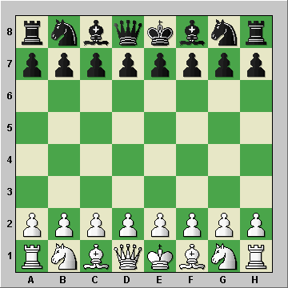

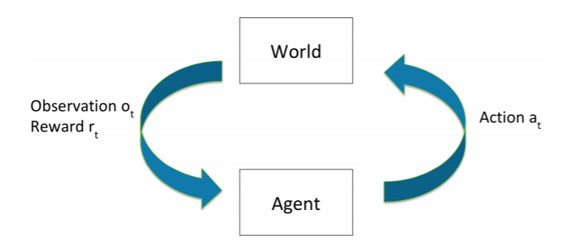
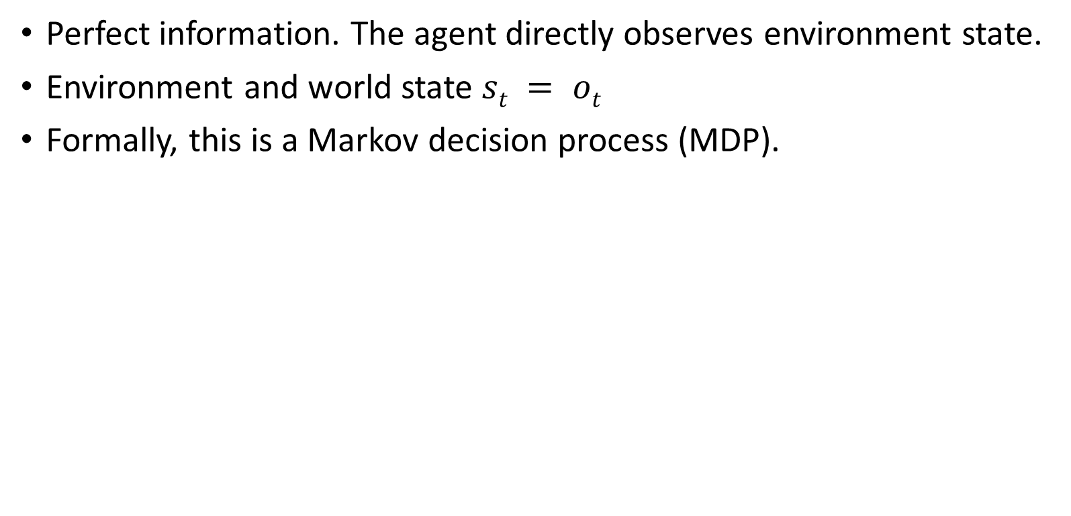
Fully Observable Environments
INTRODUCTION TO COMPUTING
Course Code: CCINCOM/L
Perfect information. The agent directly observes environment state.
Environment and world state $st = ot$
Formally, this is a Markov decision process (MDP).
Joseph Marvin R. Imperial
REINFORCEMENT LEARNING
NU College of Computing and Information Technologies
Course Code: CCRNFLRL

Slide 21
Partially Observable Environments
INTRODUCTION TO COMPUTING
Course Code: CCINCOM/L
Imperfect information. The agent indirectly observes environment.
A robot with camera vision isn’t told its absolute location.
A trading agent only observes current prices.
A poker playing agent only observes public cards.
Current agent state != complete environment state
Agent must construct its own state representation or perception of the world.
Joseph Marvin R. Imperial
REINFORCEMENT LEARNING
NU College of Computing and Information Technologies
Course Code: CCRNFLRL

Slide 22
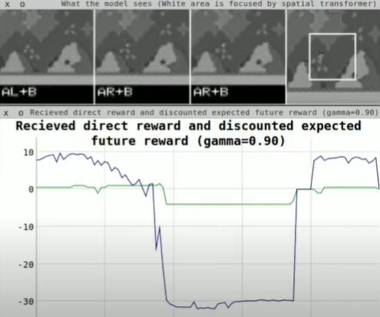
Partially Observable Environments
INTRODUCTION TO COMPUTING
Course Code: CCINCOM/L
Joseph Marvin R. Imperial
REINFORCEMENT LEARNING
NU College of Computing and Information Technologies
Course Code: CCRNFLRL

Slide 23
Major Components of an RL Agent
INTRODUCTION TO COMPUTING
Course Code: CCINCOM/L
How can the RL agent learn?
An RL agent may include one or more of these components:
Policy - agent’s behavior function or strategy .
Value function - how good is each state and/or action .
Model - agent’s representation of the environment. Optional.
Review in Probability, Intro to RL Concepts
Joseph Marvin R. Imperial
REINFORCEMENT LEARNING
NU College of Computing and Information Technologies
Course Code: CCRNFLRL

Slide 24
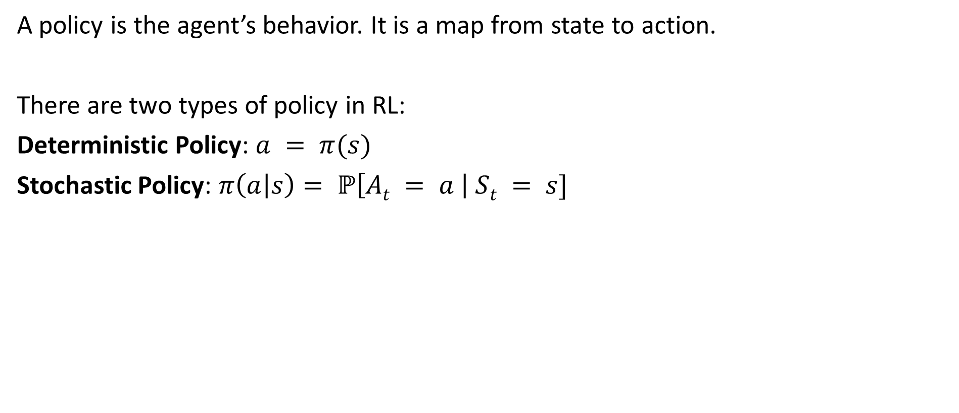

Policy $π$
INTRODUCTION TO COMPUTING
Course Code: CCINCOM/L
A policy is the agent’s behavior. It is a map from state to action.
There are two types of policy in RL:
Deterministic Policy: $a = π(s)$
Stochastic Policy: $π\left(a | s\right)= ℙ\left[At = a \right| St = s]$
Review in Probability, Intro to RL Concepts
Joseph Marvin R. Imperial
REINFORCEMENT LEARNING
NU College of Computing and Information Technologies
Course Code: CCRNFLRL

Slide 25
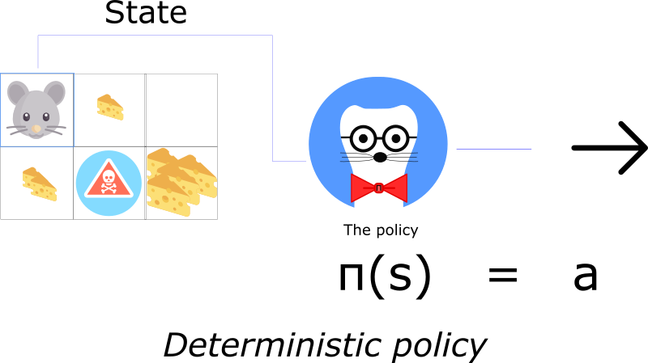
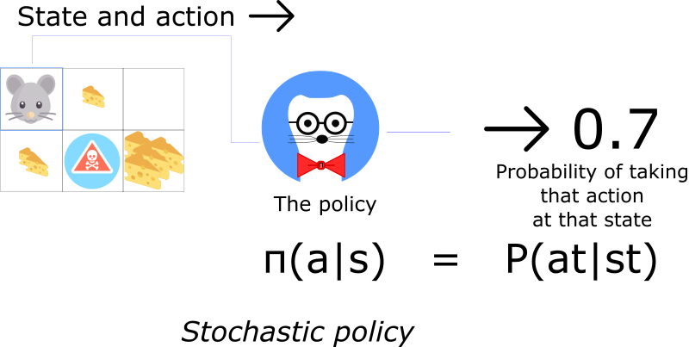
Policy $π$
INTRODUCTION TO COMPUTING
Course Code: CCINCOM/L
Review in Probability, Intro to RL Concepts
Joseph Marvin R. Imperial
REINFORCEMENT LEARNING
NU College of Computing and Information Technologies
Course Code: CCRNFLRL

Slide 26
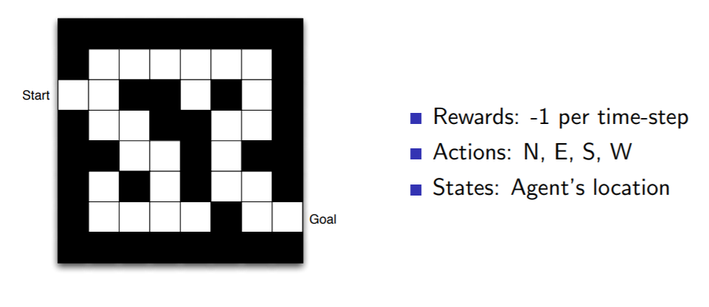
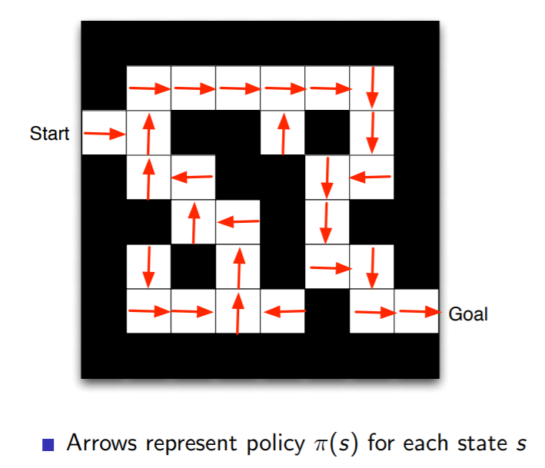

Policy $π$
INTRODUCTION TO COMPUTING
Course Code: CCINCOM/L
Review in Probability, Intro to RL Concepts
Joseph Marvin R. Imperial
REINFORCEMENT LEARNING
NU College of Computing and Information Technologies
Course Code: CCRNFLRL

Slide 27
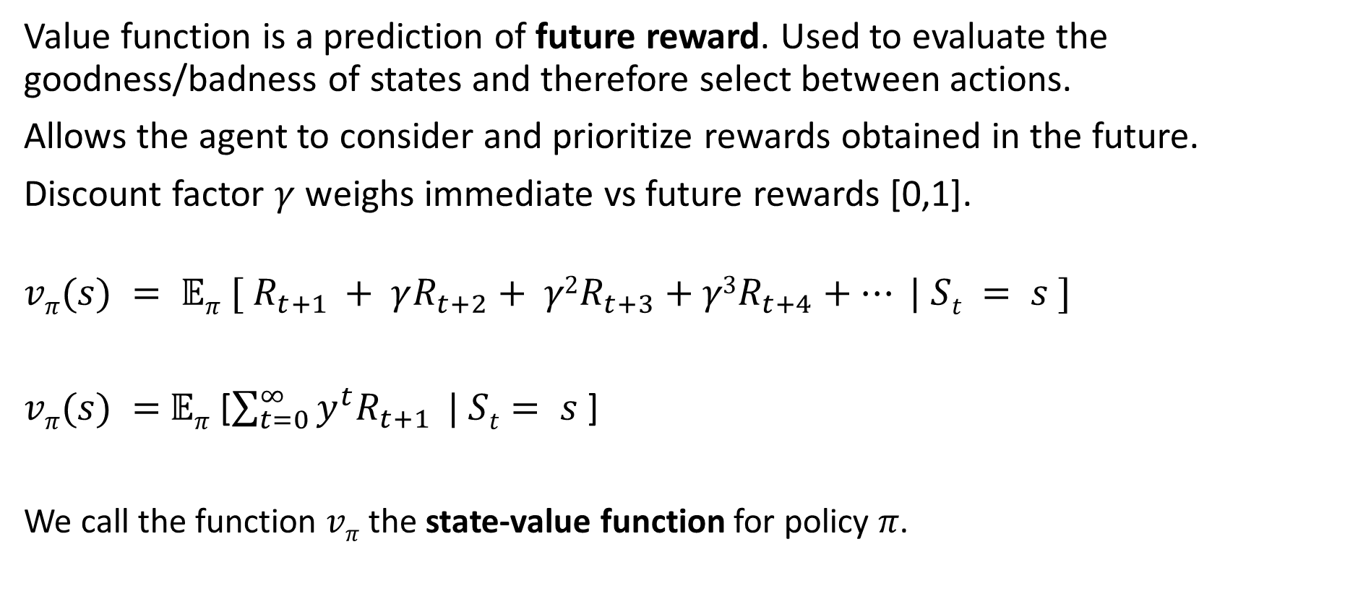
Value Function
INTRODUCTION TO COMPUTING
Course Code: CCINCOM/L
Value function is a prediction of future reward. Used to evaluate the goodness/badness of states and therefore select between actions.
Allows the agent to consider and prioritize rewards obtained in the future.
Discount factor $γ$ weighs immediate vs future rewards [0,1].
$$vπ(s) = 𝔼π [ R_{t+1} + γR_{t+2}+ γ2R_{t+3}+γ3R_{t+4}+… | St = s ]$$
$vπ(s) =$ $𝔼π$ [$\sum_{t=0}^{∞}{y^{t}R_{t+1}} | St= s$]
We call the function $vπ$ the state-value function for policy 𝜋.
Review in Probability, Intro to RL Concepts
Joseph Marvin R. Imperial
REINFORCEMENT LEARNING
NU College of Computing and Information Technologies
Course Code: CCRNFLRL

Slide 28
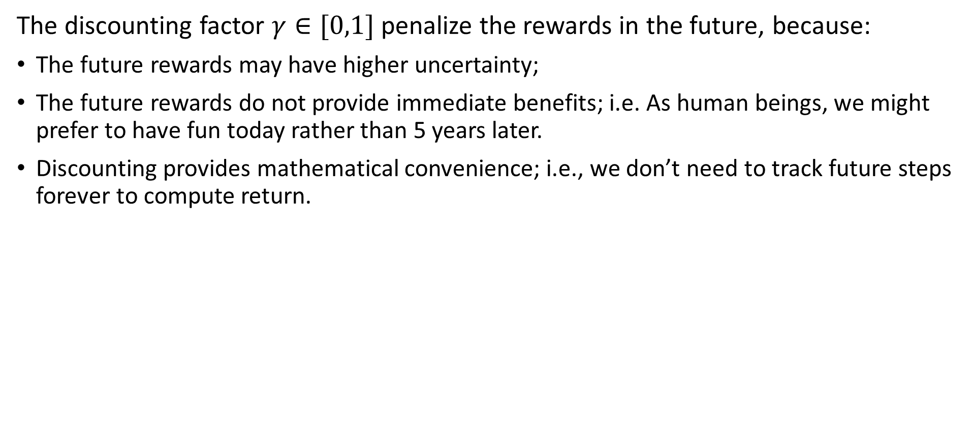
Discount Factor
INTRODUCTION TO COMPUTING
Course Code: CCINCOM/L
The discounting factor $γ∈[0,1]$penalize the rewards in the future, because:
The future rewards may have higher uncertainty;
The future rewards do not provide immediate benefits; i.e. As human beings, we might prefer to have fun today rather than 5 years later.
Discounting provides mathematical convenience; i.e., we don’t need to track future steps forever to compute return.
Review in Probability, Intro to RL Concepts
Joseph Marvin R. Imperial
REINFORCEMENT LEARNING
NU College of Computing and Information Technologies
Course Code: CCRNFLRL

Slide 29
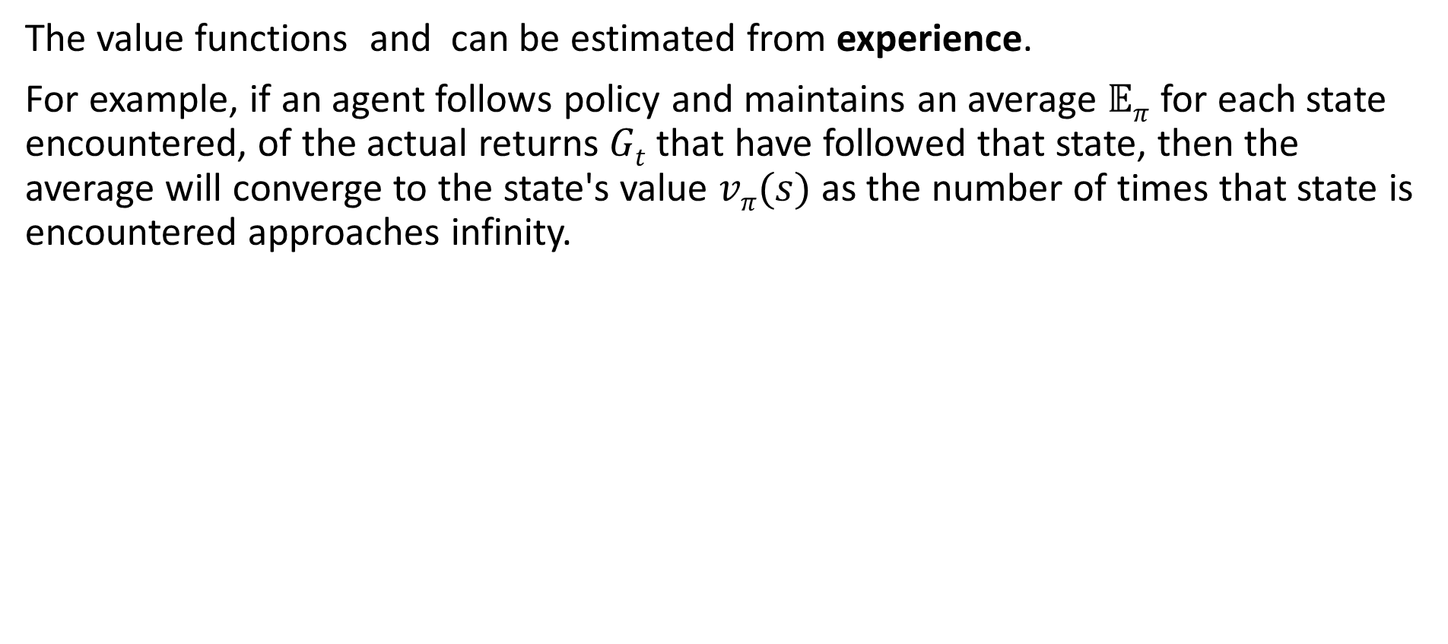
Value Function
INTRODUCTION TO COMPUTING
Course Code: CCINCOM/L
The value functions and can be estimated from experience.
For example, if an agent follows policy and maintains an average $𝔼π$ for each state encountered, of the actual returns $Gt$ that have followed that state, then the average will converge to the state's value $vπ(s)$ as the number of times that state is encountered approaches infinity.
Review in Probability, Intro to RL Concepts
Joseph Marvin R. Imperial
REINFORCEMENT LEARNING
NU College of Computing and Information Technologies
Course Code: CCRNFLRL

Slide 30
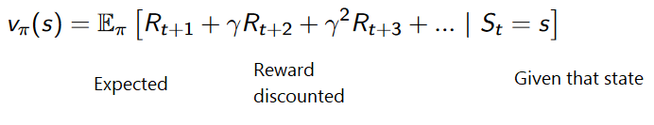
Value Function
INTRODUCTION TO COMPUTING
Course Code: CCINCOM/L
Review in Probability, Intro to RL Concepts
Joseph Marvin R. Imperial
REINFORCEMENT LEARNING
NU College of Computing and Information Technologies
Course Code: CCRNFLRL

Slide 31
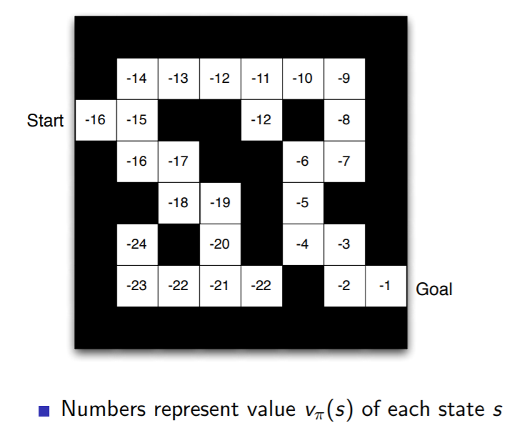
Value Function - Maze
INTRODUCTION TO COMPUTING
Course Code: CCINCOM/L
Review in Probability, Intro to RL Concepts
Joseph Marvin R. Imperial
REINFORCEMENT LEARNING
NU College of Computing and Information Technologies
Course Code: CCRNFLRL

Slide 32
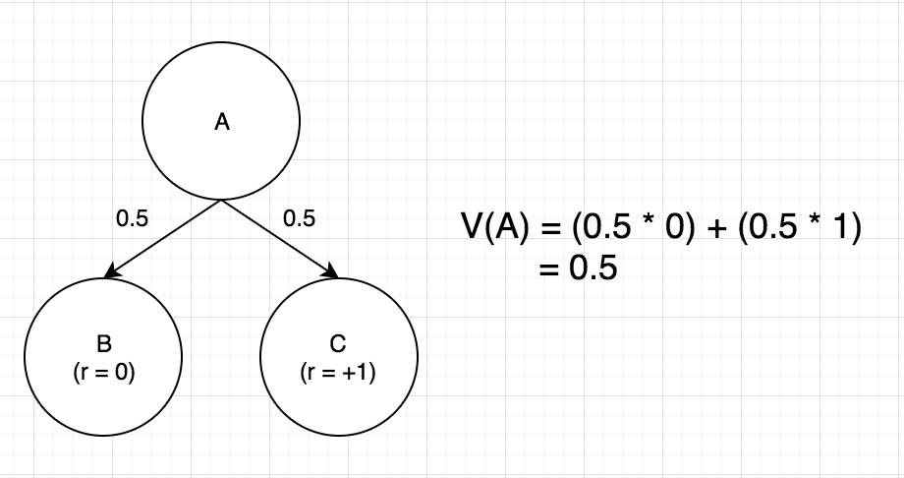
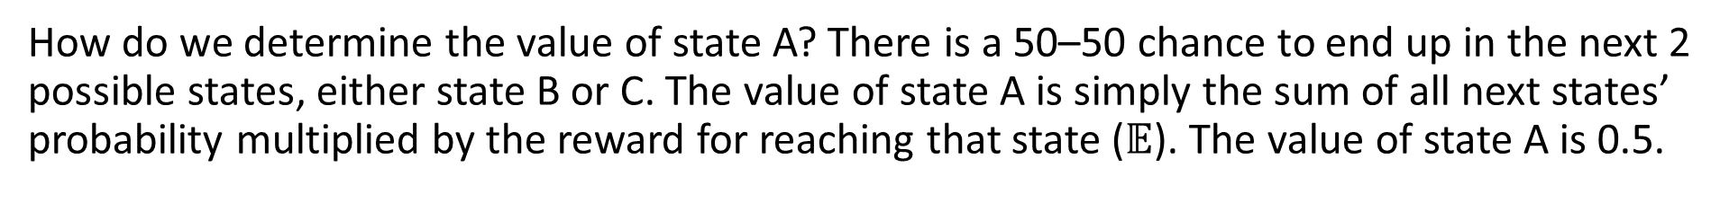
Value Function
INTRODUCTION TO COMPUTING
Course Code: CCINCOM/L
Review in Probability, Intro to RL Concepts
How do we determine the value of state A? There is a 50–50 chance to end up in the next 2 possible states, either state B or C. The value of state A is simply the sum of all next states’ probability multiplied by the reward for reaching that state ($𝔼$). The value of state A is 0.5.
Joseph Marvin R. Imperial
REINFORCEMENT LEARNING
NU College of Computing and Information Technologies
Course Code: CCRNFLRL

Slide 33
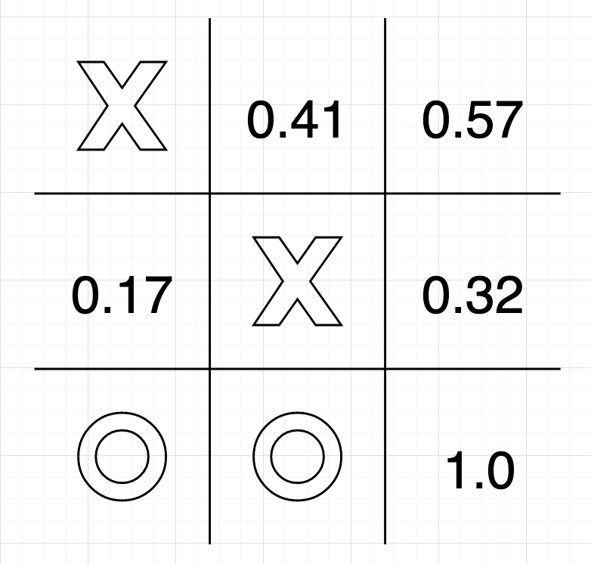
Value Function – Tic Tac Toe
INTRODUCTION TO COMPUTING
Course Code: CCINCOM/L
Given enough training, the agent would have learnt the value (or probability of winning) of any given state.
At each state of the game, the agent loop through every possibility, picking the next state with the highest value, therefore selecting the best course of action.
In the figure on the right, the agent would pick the bottom-right corner to win the game.
Review in Probability, Intro to RL Concepts
Joseph Marvin R. Imperial
REINFORCEMENT LEARNING
NU College of Computing and Information Technologies
Course Code: CCRNFLRL

Slide 34

Optimal Value Function
INTRODUCTION TO COMPUTING
Course Code: CCINCOM/L
Among all possible value-functions, there exist an optimal value function that has higher value than other functions for all states.
Review in Probability, Intro to RL Concepts
Joseph Marvin R. Imperial
REINFORCEMENT LEARNING
NU College of Computing and Information Technologies
Course Code: CCRNFLRL

Slide 35
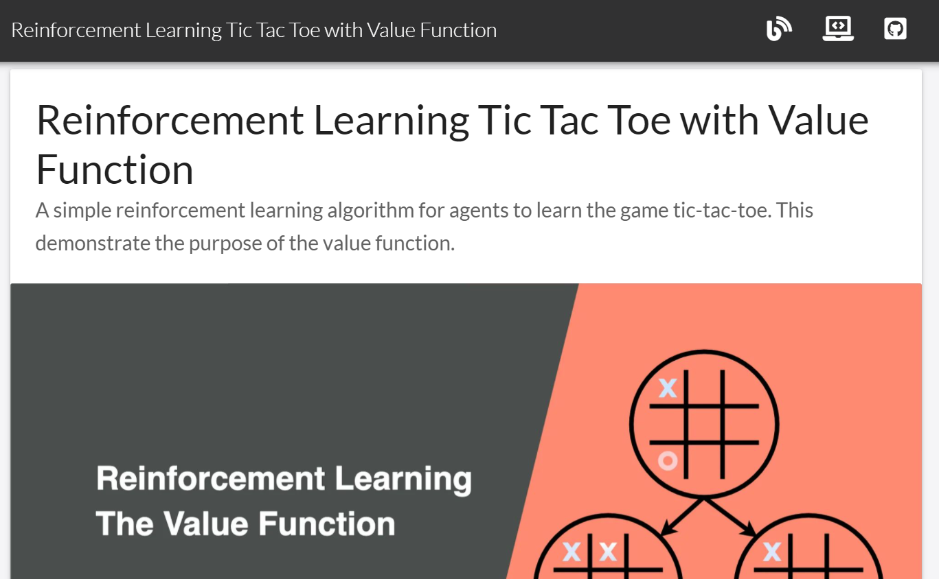
Value Function – Tic Tac Toe
INTRODUCTION TO COMPUTING
Course Code: CCINCOM/L
https://jinglescode.github.io/reinforcement-learning-tic-tac-toe/
Review in Probability, Intro to RL Concepts
Joseph Marvin R. Imperial
REINFORCEMENT LEARNING
NU College of Computing and Information Technologies
Course Code: CCRNFLRL

Slide 36
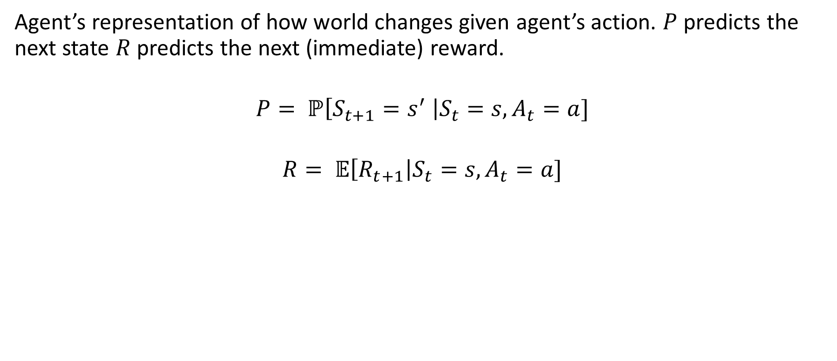
Model
INTRODUCTION TO COMPUTING
Course Code: CCINCOM/L
Agent’s representation of how world changes given agent’s action. $P$ predicts the next state $R$ predicts the next (immediate) reward.
$$P= ℙ\left[S_{t+1}=s^{′} \right|S_{t}=s, A_{t}=a]$$
$$R= 𝔼\left[R_{t+1}\right|S_{t}=s, A_{t}=a]$$
Review in Probability, Intro to RL Concepts
Joseph Marvin R. Imperial
REINFORCEMENT LEARNING
NU College of Computing and Information Technologies
Course Code: CCRNFLRL

Slide 37
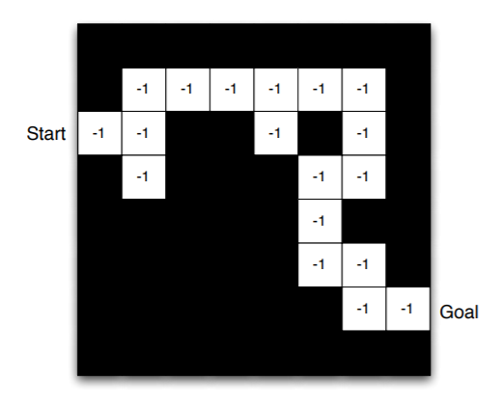
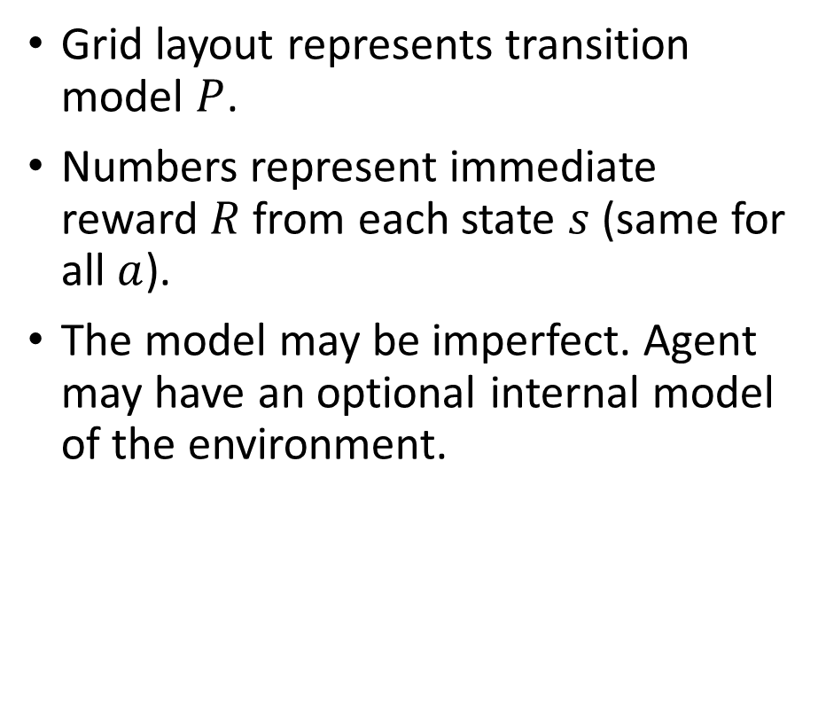
Model
INTRODUCTION TO COMPUTING
Course Code: CCINCOM/L
Grid layout represents transition model $P$.
Numbers represent immediate reward $R$ from each state $s$ (same for all $a$).
The model may be imperfect. Agent may have an optional internal model of the environment.
Review in Probability, Intro to RL Concepts
Joseph Marvin R. Imperial
REINFORCEMENT LEARNING
NU College of Computing and Information Technologies
Course Code: CCRNFLRL

Slide 38
Types of RL Agents
INTRODUCTION TO COMPUTING
Course Code: CCINCOM/L
Value Based
Makes use of the value function to choose action. The goal is to optimize the value function 𝑉(𝑠).
Policy Based
Makes use of optimizing the policy to choose action. The goal is to directly optimize the policy function 𝜋(𝑠) without using a value function.
Actor Critic
Combines both value function and optimized policy.
Review in Probability, Intro to RL Concepts
Joseph Marvin R. Imperial
REINFORCEMENT LEARNING
NU College of Computing and Information Technologies
Course Code: CCRNFLRL

Slide 39
Types of RL Agents
INTRODUCTION TO COMPUTING
Course Code: CCINCOM/L
Model-Free
We ignore the model and care less about the inner working or dynamics of the environment. We fall back to sampling to estimate rewards.
Model-Based
We model the environment. This means we create a model of the behavior of the environment. The problem is each environment will need a different model representation.
Review in Probability, Intro to RL Concepts
Joseph Marvin R. Imperial
REINFORCEMENT LEARNING
NU College of Computing and Information Technologies
Course Code: CCRNFLRL

Slide 40
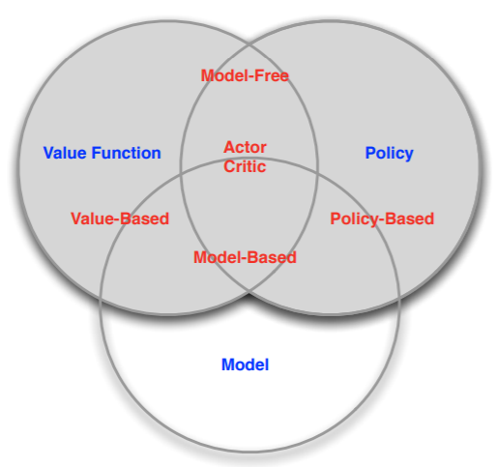
Taxonomy of RL Agents
INTRODUCTION TO COMPUTING
Course Code: CCINCOM/L
Review in Probability, Intro to RL Concepts
Joseph Marvin R. Imperial
REINFORCEMENT LEARNING
NU College of Computing and Information Technologies
Course Code: CCRNFLRL

Slide 41
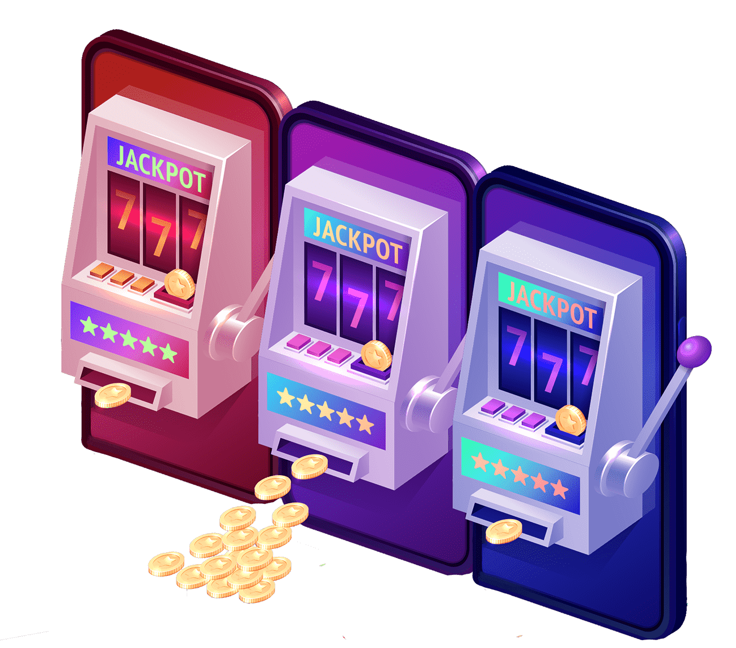
Exploration and Exploitation
INTRODUCTION TO COMPUTING
Course Code: CCINCOM/L
Reinforcement learning is like trial-and-error learning.
The agent should discover a good policy from its experiences of the environment without losing too much reward along the way.
Exploration finds more information about the environment.
Exploitation exploits known information to maximize reward.
It is usually important to explore as well as exploit.
Review in Probability, Intro to RL Concepts
Joseph Marvin R. Imperial
REINFORCEMENT LEARNING
NU College of Computing and Information Technologies
Course Code: CCRNFLRL

Slide 42
Exploration and Exploitation
INTRODUCTION TO COMPUTING
Course Code: CCINCOM/L
Restaurant Selection
Exploitation Go to your favorite restaurant.
Exploration Try a new restaurant.
Online Banner Advertisements
Exploitation Show the most successful advert.
Exploration Show a different advert.
Oil Drilling
Exploitation Drill at the best known location.
Exploration Drill at a new location.
Game Playing
Exploitation Play the move you believe is best.
Exploration Play an experimental move.
Review in Probability, Intro to RL Concepts
Joseph Marvin R. Imperial
REINFORCEMENT LEARNING
NU College of Computing and Information Technologies
Course Code: CCRNFLRL

Slide 43
References
INTRODUCTION TO COMPUTING
Course Code: CCINCOM/L
Images are licensed with Creative Commons. Can use without citing.
Prof. Emma Brunskill’s slides (CS234RL). https://web.stanford.edu/class/cs234/slides/lecture1.pdf
David Silver’s slides. https://www.davidsilver.uk/wp-content/uploads/2020/03/intro_RL.pdf
Review in Probability, Intro to RL Concepts
Joseph Marvin R. Imperial
REINFORCEMENT LEARNING
NU College of Computing and Information Technologies
Course Code: CCRNFLRL

